Slide 1

AML:3303 Data Engineering for AI: Pipelines, Practices, and System Design

Slide 2
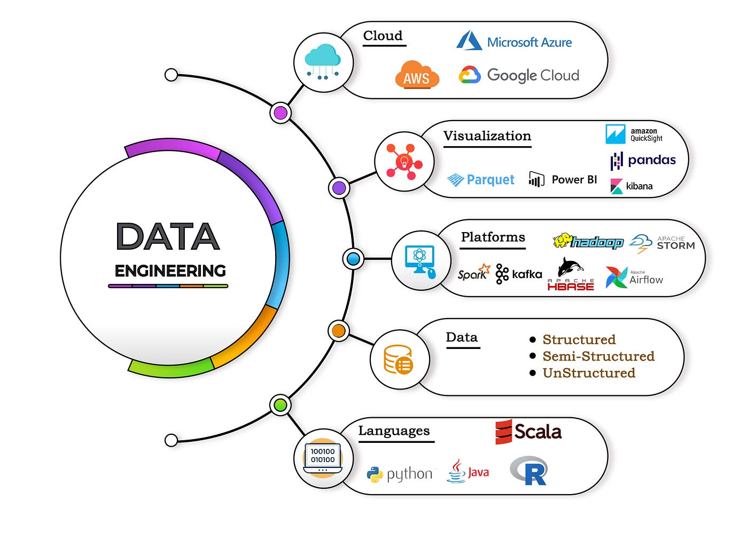
What is Data Engineering?
Discipline focused on collecting, processing, storing, and serving data.
Ensures AI models have clean, reliable, and accessible data.
Bridges the gap between raw data sources and intelligent systems.
Example: Sensor logs → processed → predictive maintenance AI model

Slide 3
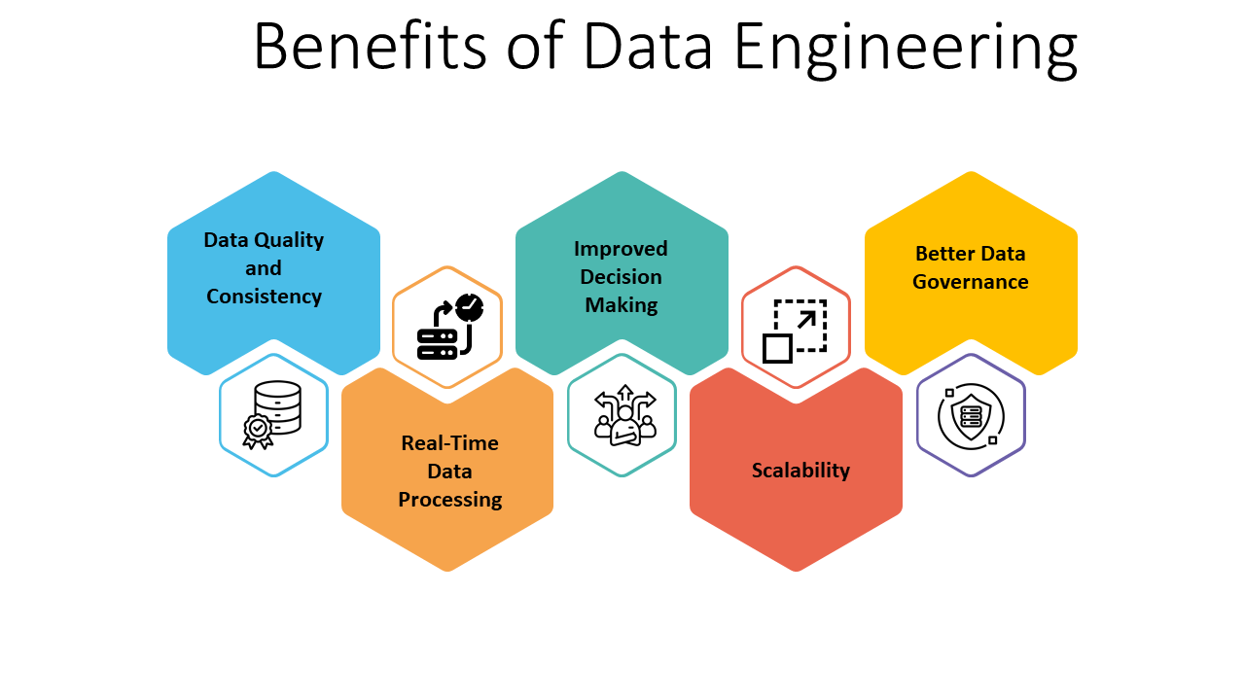
Why Data Engineering Matters
Data drives AI accuracy and business decisions.
Poor data pipelines = slow, unreliable AI outputs.
Key goals of data engineering:
  Scalability for large datasets
  Timely availability of data
  Data quality and reliability
  Supports system design discussions for data-heavy applications

Slide 4
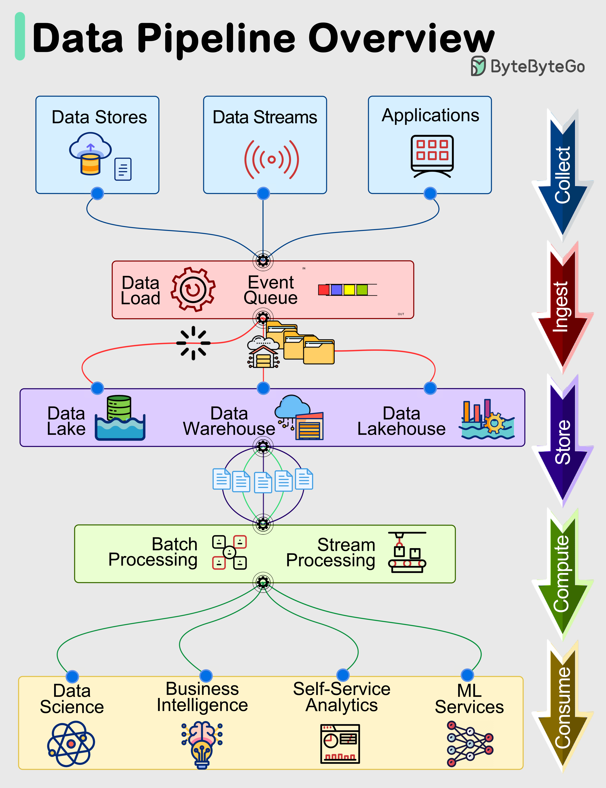
Core Components of Data Engineering
Data Ingestion: APIs, databases, streaming, IoT devices
Data Storage: Relational, NoSQL, data lakes, cloud storage
Data Processing: Batch (Spark, Hadoop) vs streaming (Kafka, Flink)
Data Quality & Governance: Cleaning, validation, compliance
Orchestration & Monitoring: Airflow, Prefect, Dagster

Slide 5
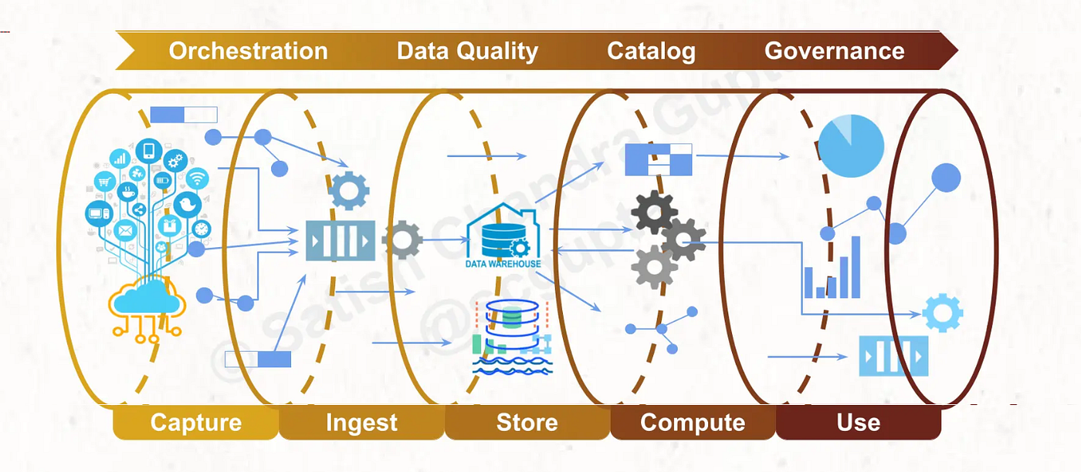
Types of Data Pipelines
ETL, ELT, CDC, ELTL – What They Mean:
ETL (Extract, Transform, Load): Data is transformed before loading.
ELT (Extract, Load, Transform): Data is loaded first, transformed later (common in cloud data lakes).
CDC (Change Data Capture): Capture and propagate only the changes in data.
ELTL (Extract, Load, Transform, Load): Hybrid approach for incremental updates and analytics.

Slide 6
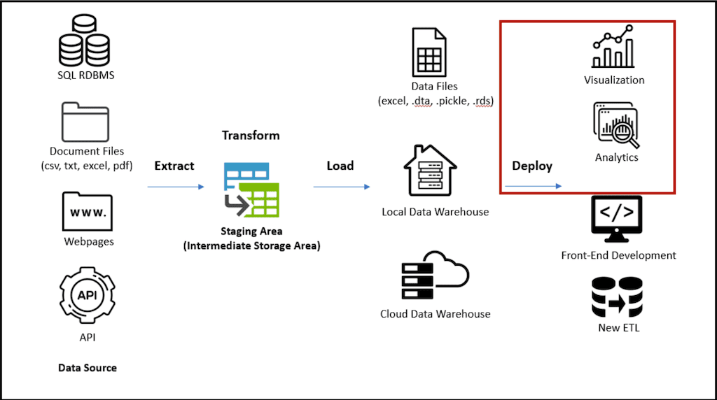
ETL – Extract, Transform, Load
Process:
Extract from sources (DBs, APIs).
Transform (clean, aggregate, normalize).
Load into a data warehouse.
Tools: Apache NiFi, Talend, Informatica, Airflow
Example:
Sales data from multiple stores → cleaned and normalized → loaded into centralized warehouse for reporting.
Tip: Best for structured data and strict schema environments.

Slide 7
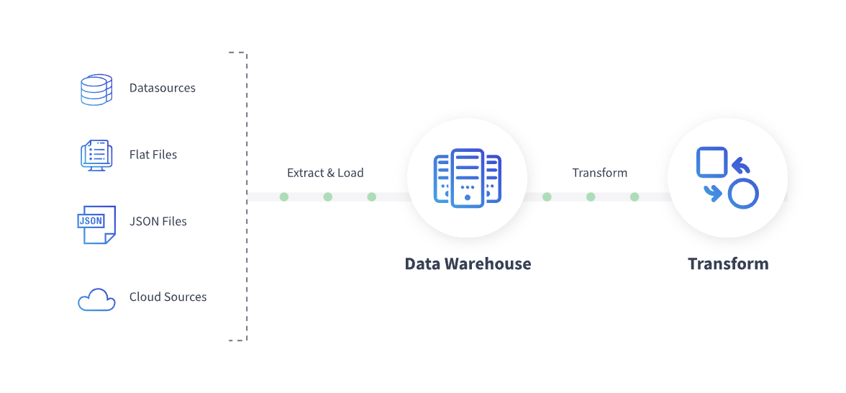
ELT – Extract, Load, Transform
Process:
Extract raw data from source.
Load into data lake or warehouse.
Transform using SQL or Spark once data is in the system.
Tools: Snowflake, BigQuery, Databricks
Example:
Clickstream logs from a website → loaded as raw JSON → transformed in Snowflake to generate user behaviour dashboards.
Tip: Suited for large-scale cloud data platforms where computation is cheap.

Slide 8
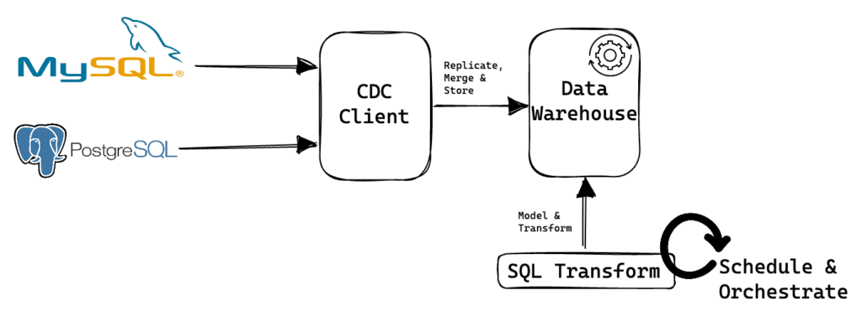
Change Data Capture (CDC)
Purpose: Keep data synchronized across systems in near real-time.
Process:
Detect inserts, updates, deletes in source DB.
Propagate changes to target system efficiently.
Tools: Debezium, AWS DMS, Kafka Connect
Example:
E-commerce inventory system → updates in real-time → reflected in data warehouse for dashboards and AI recommendations.

Slide 9
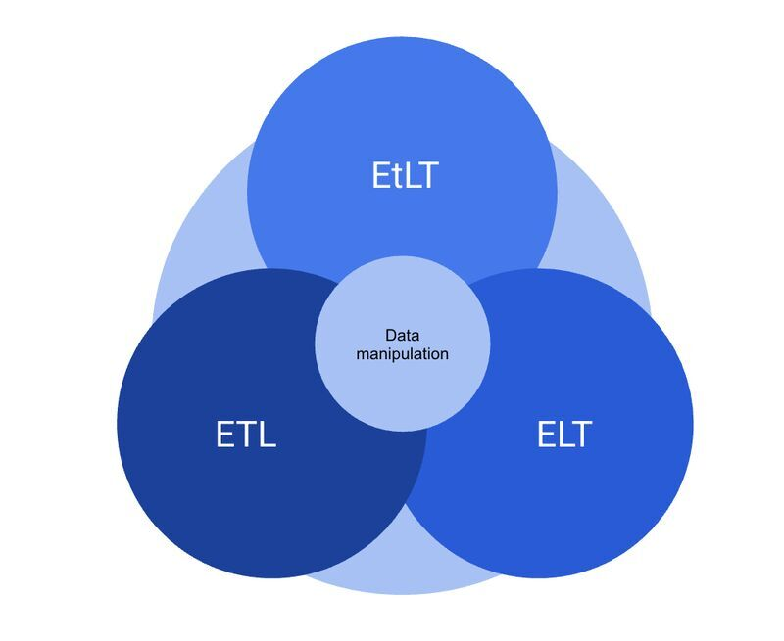
EtLT and Reverse ETL
EtLT: extract, light transform (mask PII, fix types), load, then transform fully in the warehouse.
Why: clean what must be cleaned early, keep the heavy work in the warehouse.
Reverse ETL: push warehouse results back into business tools such as CRM, Slack or ads platforms.
Example: bank transactions → mask card numbers → load → fraud scores → reverse ETL to the fraud team's case tool.
Tools: dbt for transforms; Hightouch, Census for reverse ETL.

Slide 10
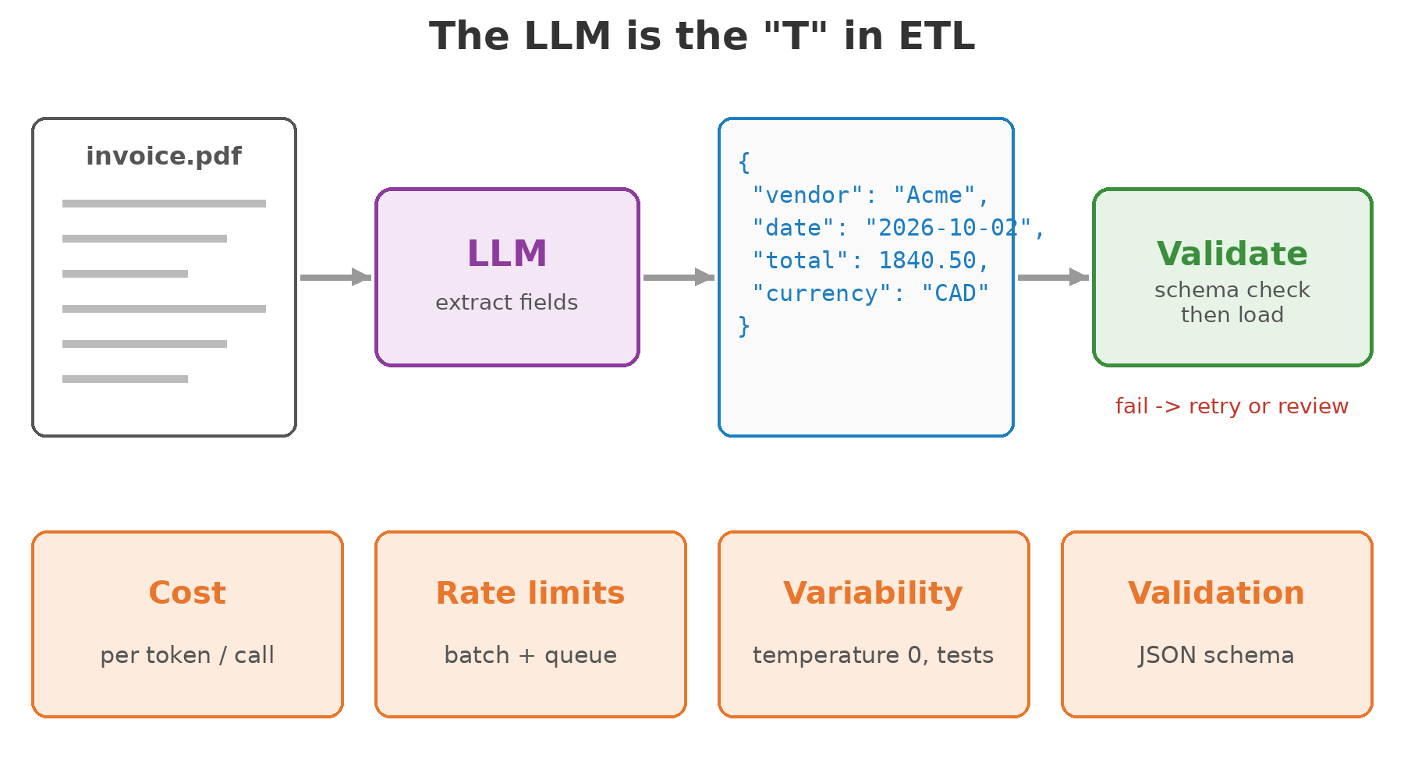
LLMs as a Transformation Step
Purpose: turn unstructured text into structured rows.
Examples: extract invoice fields, classify support tickets, summarise call notes, tag sentiment.
New engineering concerns: cost per call, rate limits, outputs that vary between runs.
Tip: use temperature 0, batch APIs and caching, and validate every JSON output before loading it.

Slide 11
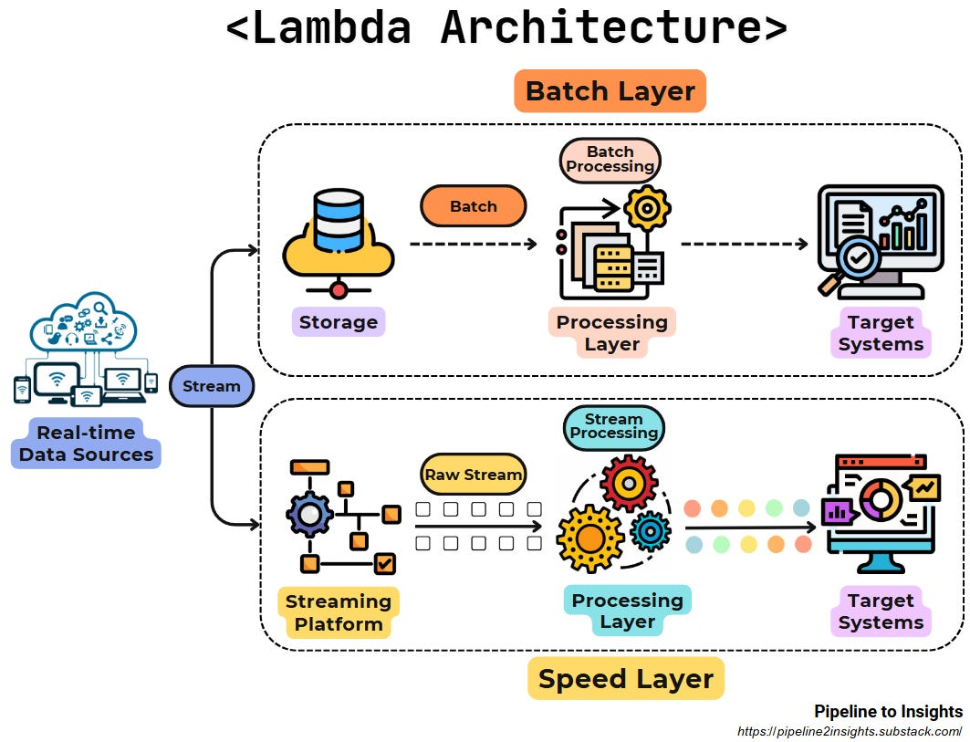
Data Pipeline Architecture – Industry Practices
Batch vs Streaming:
Batch: Scheduled ETL jobs, e.g., daily reports
Streaming: Real-time processing with Kafka, Flink, Spark Streaming
Lambda vs Kappa:
Lambda: a batch layer and a speed layer, merged for serving (diagram)
Kappa: one streaming path for everything; replay the stream to reprocess
Orchestration: Automate pipelines using Airflow/Prefect
Monitoring & Alerting: Data quality checks, SLA monitoring

Slide 12
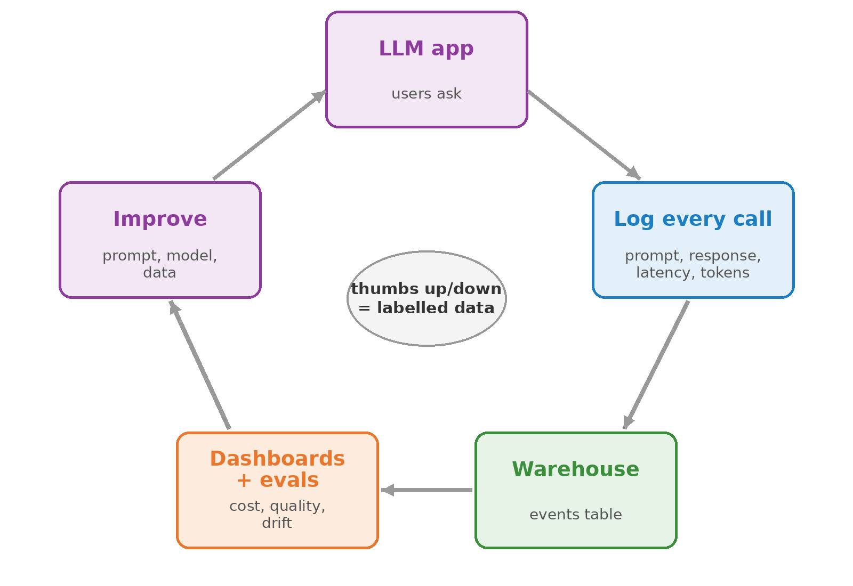
LLMOps: Logging, Evaluation and Feedback
Every LLM call is data: prompt, response, latency, tokens, cost.
Pipeline: log events, land them in the warehouse, build dashboards and evaluation sets.
User feedback (thumbs up or down) becomes labelled data.
Monitor: cost per day, error rate, answer quality, drift.
Tools: Langfuse, MLflow, Arize Phoenix.

Slide 13
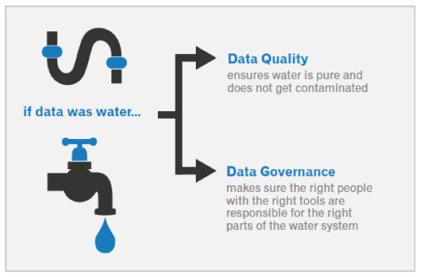
Data Quality & Governance
Data Profiling & Cleaning: Detect missing, inconsistent, or corrupted data
Metadata Management: Track schema, lineage, and transformations
Compliance: PIPEDA (Canada), GDPR (EU), HIPAA (US health) and industry rules
Best Practices: Logging, testing transformations, and reproducible pipelines

Slide 14
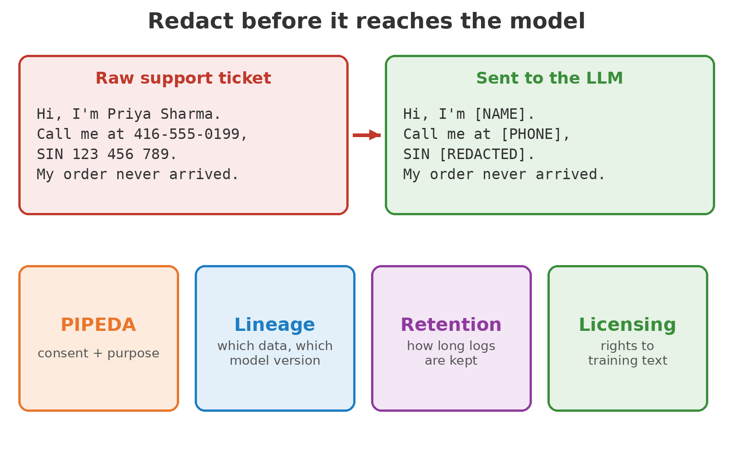
Governance for GenAI Data
PII redaction before text reaches a model or a log.
PIPEDA: Canadian rules on consent and purpose for personal data.
Lineage: which dataset version trained or fed which model.
Retention: how long prompts and responses are stored.
Licensing: do you have the rights to the training text?

Slide 15
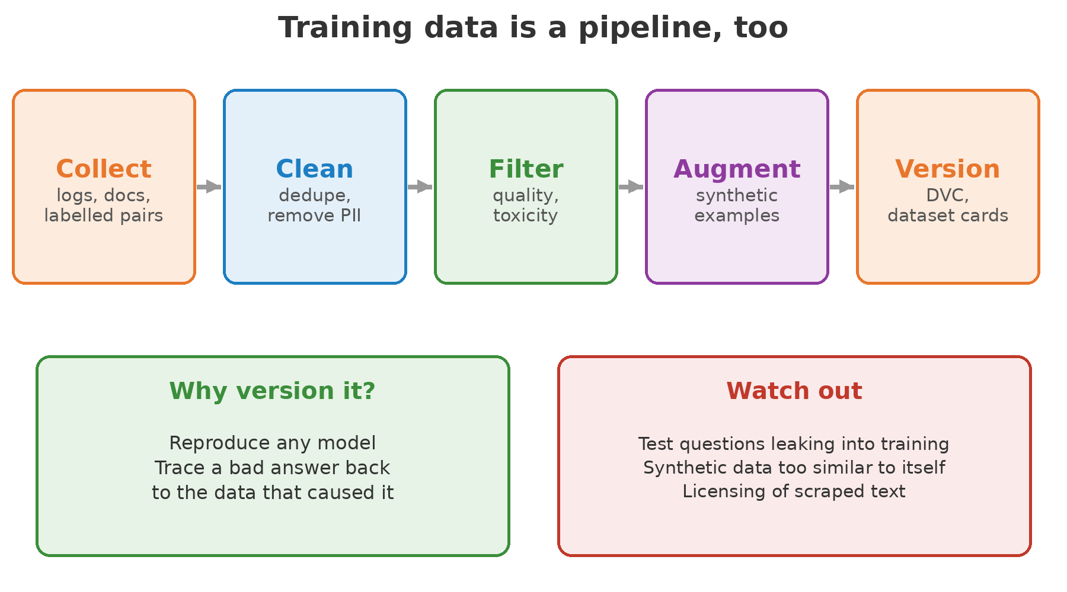
Data Pipelines for Training and Fine-Tuning
Purpose: prepare the examples a model learns from.
Steps: collect, deduplicate, remove PII, filter for quality, augment, version.
Synthetic data: LLM-generated examples fill gaps and rare cases.
Tools: DVC, Hugging Face Datasets, dataset cards.
Tip: keep test questions out of training data, or the evaluation is meaningless.

Slide 16
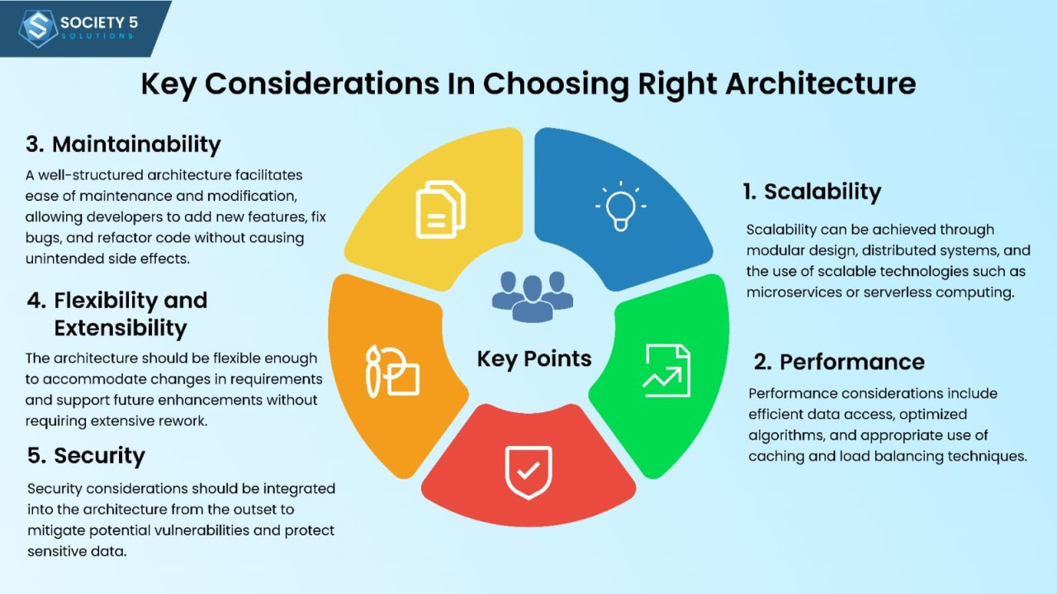
System Design Considerations for Data Engineering
Scalability: Use partitioning, sharding, and distributed storage
Latency: Batch vs near real-time pipeline design
Consistency: How to handle eventual consistency in distributed systems
Fault Tolerance: Retry strategies, checkpointing in streaming pipelines
Cost Efficiency: Optimize cloud storage and compute usage

Slide 17
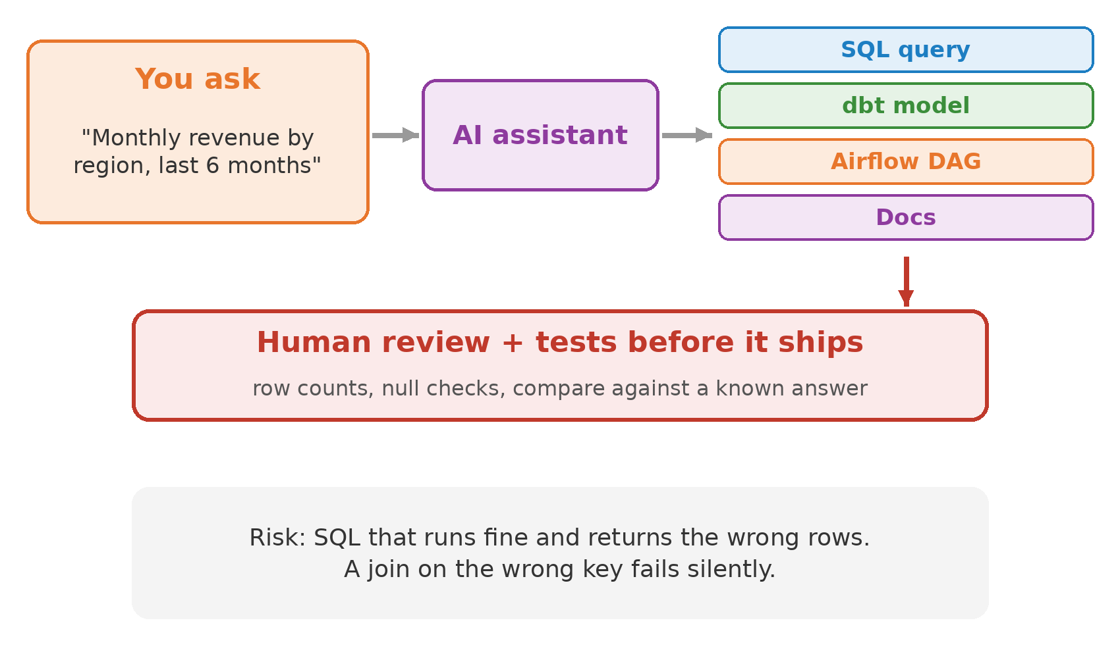
AI-Assisted Data Engineering
Text-to-SQL: describe the question, get a query.
Code generation: dbt models, Airflow DAGs, tests and documentation.
Data catalogs: AI-written column and table descriptions.
Tip: AI-written SQL can run without errors and still be wrong. Test it against a known answer.

Slide 18
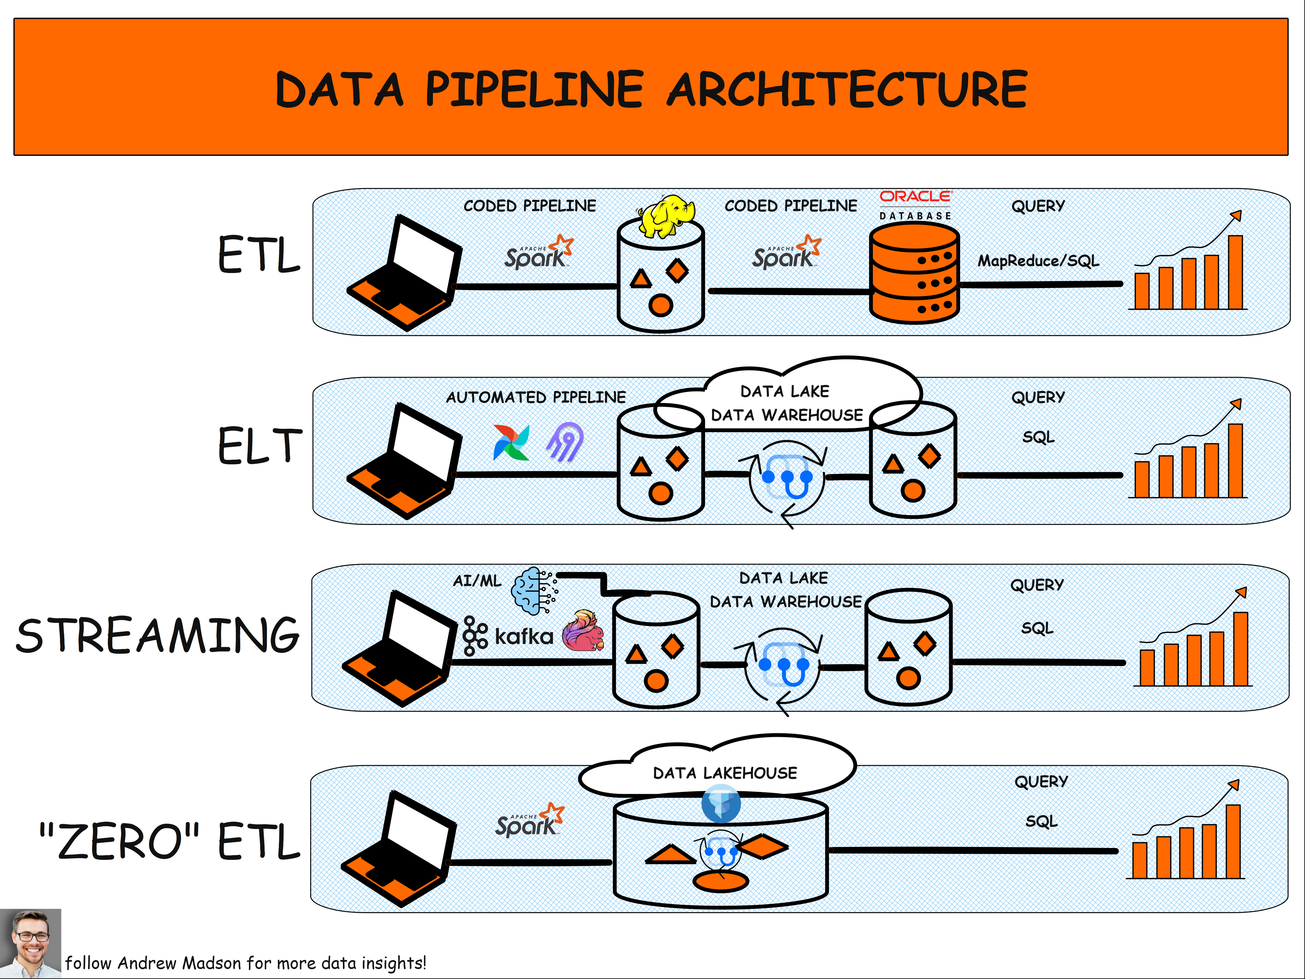
Notes:
https://bytebytego.com/guides/data-pipelines-overview/

